Slide 1
Cell Parts
Organelles – “little organs” found inside the cell.
Each organelle has a unique function.

Slide 2
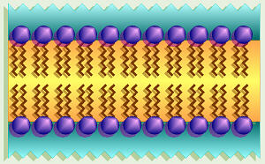
Plasma Membrane
Definition/Function
Diagram/Description
Barrier that surrounds all cells.
Controls what enters and leaves the cell.
Notice the two layers of molecules (phospholipids)

Slide 3
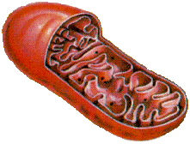
Mitochondria
Definition/Function
Diagram/Description
Breaks down food to make energy.
“Powerhouse” of the cell.
Performs cellular respiration.
Notice all the folds on the inside – increases surface area for greater efficiency.

Slide 4
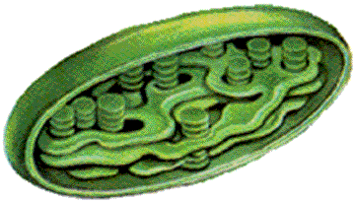
Chloroplast
Definition/Function
Diagram/Description
Uses sunlight to make sugars.
Performs photosynthesis.
Notice the extensive folding on the inside – increases surface area.
Contains a green pigment – therefore, frequently shown as a green structure.

Slide 5
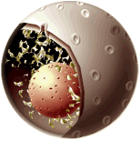
Nucleus
Definition/Function
Diagram/Description
Contains the genetic material (DNA) of a cell.
Sometimes considered the “brain” of the cell.
Notice the additional structure on the inside (nucleolus) and the holes in the surface (pores).

Slide 6
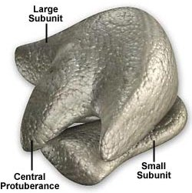
Ribosome
Definition/Function
Diagram/Description
Site of protein synthesis.
Can be found on Endoplasmic Reticulum or floating freely in the cell.
Frequently pictured as dots, but a closer look shows two distinct sections.

Slide 7
Rough Endoplasmic Reticulum
Definition/Function
Diagram/Description
Transport system for chemicals, specifically proteins.
Rough due to ribosomes attached to the surface.

Slide 8
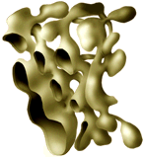
Smooth Endoplasmic Reticulum
Definition/Function
Diagram/Description
Transport system for chemicals, specifically lipids.
Smooth because of absence of ribosomes.

Slide 9
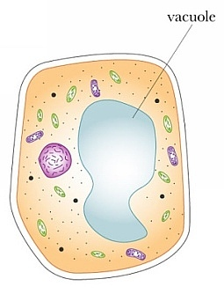
Vacuole
Definition/Function
Diagram/Description
Storage of water.
May also store nutrients and wastes.
Notice the bag-like shape: important for storing materials.

Slide 10
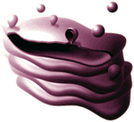
Golgi
Definition/Function
Diagram/Description
Packaging of chemicals for transport throughout and out of the cell.
Materials are packed in bubbles called vesicles.
Sometimes looks like flattened stacks of pancakes.

Slide 11
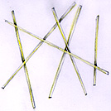
Cytoskeleton
Definition/Function
Diagram/Description
Provides structure and support.
Made up of different types of proteins.
Looks like rods – they are protein fibers.

Slide 12
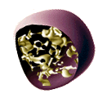
Lysosome
Definition/Function
Diagram/Description
Contains enzymes used for breaking down large molecules and old cell parts.
Remember that “lyse” means to destroy.

Slide 13
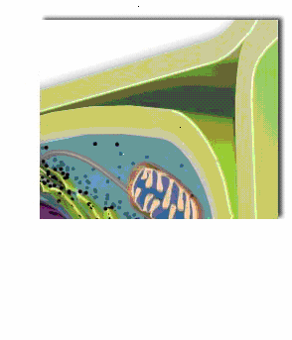
Cell Wall
Definition/Function
Diagram/Description
Provides structure and support.
Located outside of the plasma membrane.
Gives cells a very defined shape.

Slide 14
Nucleolus
Definition/Function
Diagram/Description
Where ribosomes are made.
Notice that the nucleolus is found inside of the nucleus.

